Slide 1
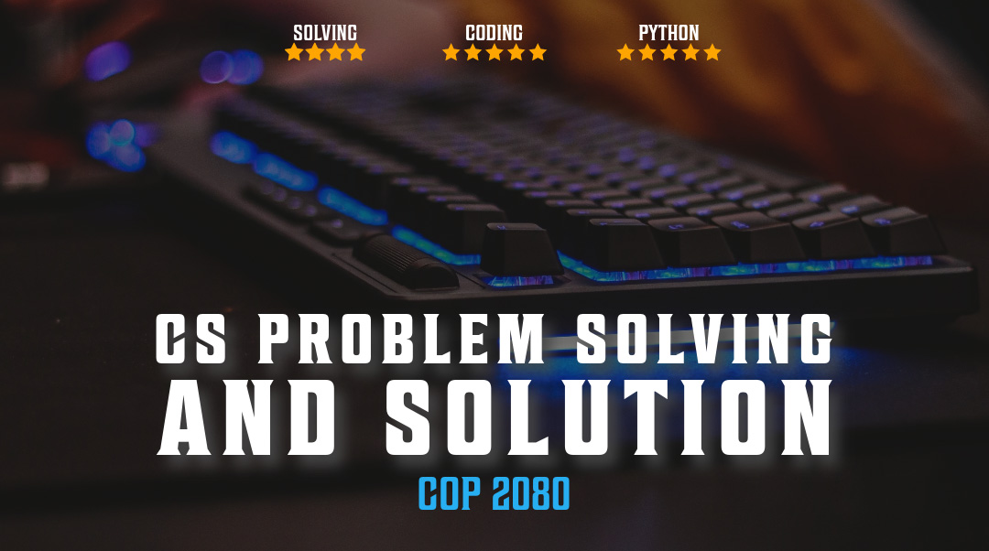

Tkinter GUI pt 2

Slide 2

Overview pt 2
BeautifulSoup
Tkinter
Graphical User Interfaces
https://docs.python.org/3.8/library/tkinter.html

Slide 3
Tkinter Basics
# p_survey_var.py
# Create the root window root = tk.Tk() # set the title root.title('CS Problem Solving and Solution Survey’)
# set the root window size root.geometry('640x480+300+300') root.resizable(False, False)
title = tk.Label( root, text='Please take survey', font=('Arial 16 bold'), bg='black', fg='white' )
Every Tkinter program must have one root window before any other
Root window represents both top-level window and application itself
Root is an instance of Tk class
Destroying root stops the program
root = tk.Tk()
root.title will display title at top of gui
Label widget, is a panel that can display some text.
The first argument to any Tkinter widget is always the parent widget (sometimes called master widget); in this case, we've passed in a reference to our root window.
reference to our root window.

Slide 4
Tkinter Stringvar()
# Use string vars for strings name_var = tk.StringVar(root) name_label = tk.Label(root, text='What is your name?') name_inp = tk.Entry(root, textvariable=name_var) # Use boolean var for True/False like_var = tk.BooleanVar() language_inp = tk.Checkbutton( root, variable=like_var, text='Check this box if you like Python' ) # Use int var for whole numbers # Value can set a default num_var = tk.IntVar(value=3) num_label = tk.Label(text='How many hours do you work on Python homework a week?') # note that even with an intvar, the key is still 'textvariable' num_inp = tk.Spinbox( root, textvariable=num_var, from_=0, to=1000, increment=1 )
Variable defined using StringVar() holds a string data text value that can be retrieved.
Can pass this variable to textvariable parameter for a tk widget like Entry.
Widget will automatically get updated with the new value whenever the value of the StringVar() variable changes.
The IntVar is used to store integers for use in the Spinbox widget
Num_var store a default value for textvariable in Spinbox
Pass in parameters

Slide 5
Tkinter OptionMenu
# Use OptionMenu with variables instead of Listbox language_var = tk.StringVar(value='Any') language_label = tk.Label( root, text='What is the best programming language?’ ) language_choices = ( 'Any', 'C', 'C++', 'Java', 'Javascript', 'Python’) language__inp = tk.OptionMenu( root, language_var, *language_choices) python_label = tk.Label(root, text='Do you expect an A in COP2080?') # Use a Frame to keep widgets together alpha_frame = tk.Frame(root) python_var = tk.BooleanVar() # The radio buttons are connected by using the same variable alpha_yes_inp = tk.Radiobutton( alpha_frame, text='Yes', value=True, variable=python_var )
OptionMenu holds a list of options as strings, need to create a StringVar to bind
Specify the options
Constructor takes the control variable and options as positional arguments
menu = tk.OptionMenu(parent, ctrl_var, opt1, opt2, ..., optN)
The Radiobutton widget handles variables slightly differently from other widgets as well. Need to bind all the buttons that are grouped together to the same control variable
Give each widget a value that matches the variable type.
Pass in parameters

Slide 6
On Submit function
def on_submit(): """To be run when the user submits the form""" # Vars all use 'get()' to retreive their variables name = name_var.get() # Because of IntVar, .get() will try to convert # the contents of num_var to int. try: number = num_var.get() except tk.TclError: number = 10000 # OptionMenu makes things simple language_ = language_var.get() # Checkbutton and Radiobutton values python_liker = like_var.get() python_user = python_var.get() # Text widgets require a range haiku = python_haiku_inp.get('1.0', tk.END)
Not all Tkinter widgets work with control variables. Text widget used for the python_haiku_inp input cannot be bound to a variable.
Using control variables in a callback function
get() method is used to retrieve a variable's value, using incorrect var binding can lead to exception. Use try/except
Get() on text field starts on line 1 character 0 and contines to end of text field.

Slide 7
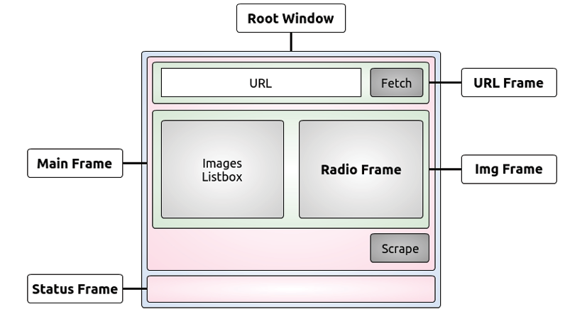
Gui_scrape.py frame layout
Pass in parameters

Slide 8
Build gui_scrape.py
# gui_scrape.py
from tkinter import * from tkinter import ttk,filedialog,messagebox
Import the tkinter package
Import ttk, filedialog, and messagebox explicitly, as not part of *. ttk is Tkinter's new set of styled widgets.
set up the main window, which is an instance of the Tk class. Instantiate it and give it a title.
Main Frame is a ttk.Frame instance. Set _root as its parent, and give it some padding.
place _mainframe on the first row (0) and first column (0) of the parent object (_root).
frame needs to extend itself in each direction by using the sticky argument with all four cardinal directions.
if __name__ == "__main__": # execute logic if run directly _root = Tk() # instantiate instance of Tk class _root.title('Scrape app')
_mainframe = ttk.Frame(_root, padding='5 5 5 5 ') # root is parent of frame _mainframe.grid(row=0, column=0, sticky=("E", "W", "N", "S")) # placed on first row,col of parent # frame can extend itself in all cardinal directions _url_frame = ttk.LabelFrame( _mainframe, text='URL', padding='5 5 5 5') # label frame _url_frame.grid(row=0, column=0, sticky=("E","W")) # only expands E W _url_frame.columnconfigure(0, weight=1) _url_frame.rowconfigure(0, weight=1) # behaves when resizing

Slide 9
Frames of gui_scrape.py
_url_frame = ttk.LabelFrame( _mainframe, text='URL', padding='5 5 5 5') # label frame _url_frame.grid(row=0, column=0, sticky=("E","W")) # only expands E W _url_frame.columnconfigure(0, weight=1) _url_frame.rowconfigure(0, weight=1) # behaves when resizing
Place the URL Frame object in _mainframe, as a LabelFrame
Can set the text argument and have rectangle drawn around it, with the content of the text argument written in the top-left part of it
frame at (0, 0), and expands to the left (W) and right (E).
rowconfigure() and columnconfigure() to make sure it behaves correctly when resizing.
_url = StringVar() _url.set('http://localhost:8000') # sets initial value of _url _url_entry = ttk.Entry( _url_frame, width=40, textvariable=_url) # text box _url_entry.grid(row=0, column=0, sticky=(E, W, S, N), padx=5) # grid mgr places object at position _fetch_btn = ttk.Button( _url_frame, text='Fetch info', command=fetch_url) # create button # fetch_url() is callback for button press _fetch_btn.grid(row=0, column=1, sticky=W, padx=5)

Slide 10

Frames of gui_scrape.py
_url = StringVar() _url.set('http://localhost:8000') # sets initial value of _url _url_entry = ttk.Entry( _url_frame, width=40, textvariable=_url) # text box _url_entry.grid(row=0, column=0, sticky=(E, W, S, N), padx=5) # grid mgr places object at position _fetch_btn = ttk.Button( _url_frame, text='Fetch info', command=fetch_url) # create button # fetch_url() is callback for button press _fetch_btn.grid(row=0, column=1, sticky=W, padx=5)
A textbox called Entry. instantiate it setting _url_frame as its parent and textvariable argument to be _url. _url is a StringVar, which is an object that is now connected to Entry and will be used to manipulate its content.
position _url_entry at (0, 0), setting all four cardinal directions for it to stick to with padding
Every time call the .grid() method on an object, tells the grid layout manager to place that object somewhere, according to arguments in the grid() call.
Place the _fetch button. Parameter is command=fetch_url means when click this button, call the fetch_url() function. This technique is called callback.
# img_frame contains Lisbox and Radio Frame _img_frame = ttk.LabelFrame( _mainframe, text='Content', padding='9 0 0 0') _img_frame.grid(row=1, column=0, sticky=(N, S, E, W))
The _img_frame is on the second row of parent _mainframe.
It hosls Listbox and Radio Frame

Slide 11

Listbox of gui_scrape.py
# Set _img_frame as parent of Listbox and _images is variable tied to _images = StringVar() _img_listbox = Listbox( _img_frame, listvariable=_images, height=6, width=25) _img_listbox.grid(row=0, column=0, sticky=(E, W), pady=5) #Scrollbar can move vertical _scrollbar = ttk.Scrollbar( _img_frame, orient=VERTICAL, command=_img_listbox.yview) _scrollbar.grid(row=0, column=1, sticky=(S, N), pady=6) _img_listbox.configure(yscrollcommand=_scrollbar.set)
Drive the contents of Listbox binding to _images var. Listbox has parent _img_frame and var _images bound to it
Pass in dimension attributes
_scrollbar set to VERTICAL orientation
Instantiate Listbox, set command to _im_listbox.yview
_img_listbox.configure() method sets the rest of the properties
Scrollbar will move with Listbox as they are connected
#Listbox occupies (0,0) on _img_frame. # Scrollbar occupies (0,1) so _radio_frame goes to (0,2) _radio_frame = ttk.Frame(_img_frame) _radio_frame.grid(row=0, column=2, sticky=(N, S, W, E))
Listbox is in 0,0, Scrolbar is in 0,1, so _radio_frame will start at 0,2 position.

Slide 12
Labels and json
_choice_lbl = ttk.Label( _radio_frame, text="Choose how to save images") _choice_lbl.grid(row=0, column=0, padx=5, pady=5) _save_method = StringVar() _save_method.set('img') # Radiobutton connected to _save_method variable # Know which button is selected by checking value _img_only_radio = ttk.Radiobutton( _radio_frame, text='As Images', variable=_save_method, value='img') _img_only_radio.grid(row=1, column=0,padx=5, pady=2, sticky="W") _img_only_radio.configure(state='normal') _json_radio = ttk.Radiobutton( _radio_frame, text='As JSON', variable=_save_method, value='json') _json_radio.grid(row=2, column=0, padx=5, pady=2, sticky="W")
Place label with padding., child of _radiof
Radiobutton driven by bond to _save_method
Each RB instance sets up value argument by checking value on _save_method

Slide 13
Buttons
_scrape_btn = ttk.Button( _mainframe, text='Scrape!', command=save) _scrape_btn.grid(row=2, column=0, sticky=E, pady=5)
third row of _mainframe (2), place the Scrape! button.
Command is save, which saves the images to be listed in Listbox, after parsing a web page.
Placing the status frame, with ttk.Frame.
Relief property to 'sunken’ & 2px padding
Stick to the left, right, and bottom parts of the _root window, with (E, W, S).
Place a label in it bound to StringVar object, becausewill need to modify it every time to update the status bar text.
_status_frame = ttk.Frame( _root, relief='sunken', padding='2 2 2 2') _status_frame.grid(row=1, column=0, sticky=("E", "W", "S")) _status_msg = StringVar() # need modified when update status text _status_msg.set('Tye a URL to start scraping...') _status= ttk.Label( _status_frame, textvariable=_status_msg, anchor=W) _status.grid(row=0, column=0, sticky=(E, W))
_root.mainloop() # listens for events, blocks any code that comes after it
Call mainloop() on Tk instance to run gui application & event listen

Slide 14
Learn more about tkinter
https://docs.python.org/3/library/tk.html
https://docs.python.org/3/library/tkinter.html
https://visualtk.com/
https://www.w3schools.in/python/gui-programming

